Slide 1
MIND Study plots and tabulations

Slide 2
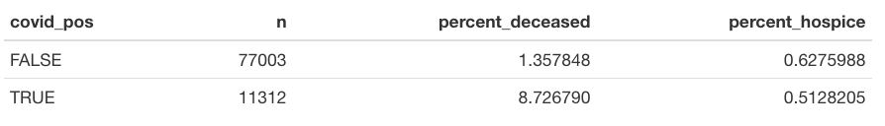
Overall mortality among covid and non-covid patients (ever vs never positive pcr test) – through 2/24

Slide 3
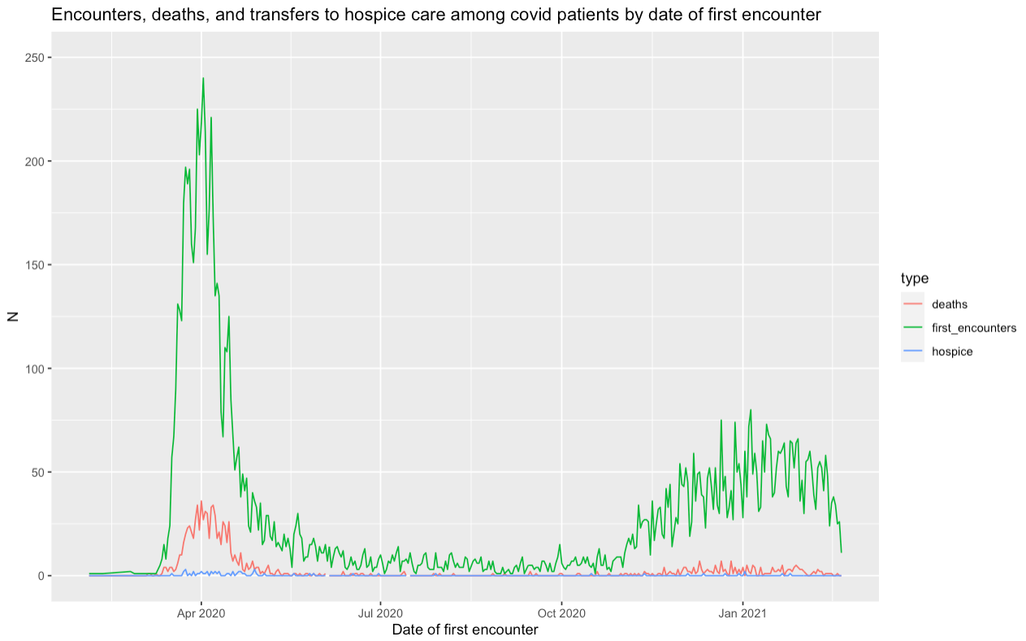

Slide 4
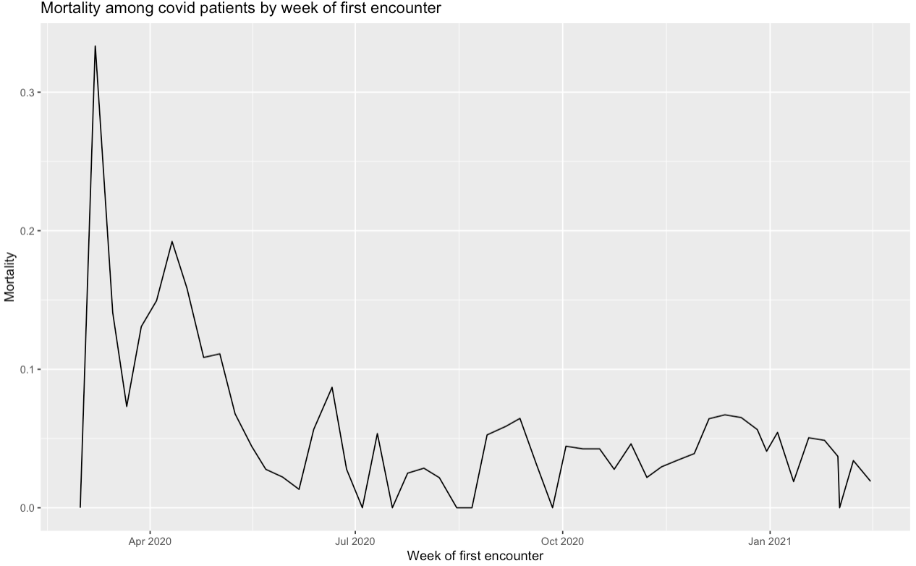
Notes:
(does not include transfers to hospice care)

Slide 5
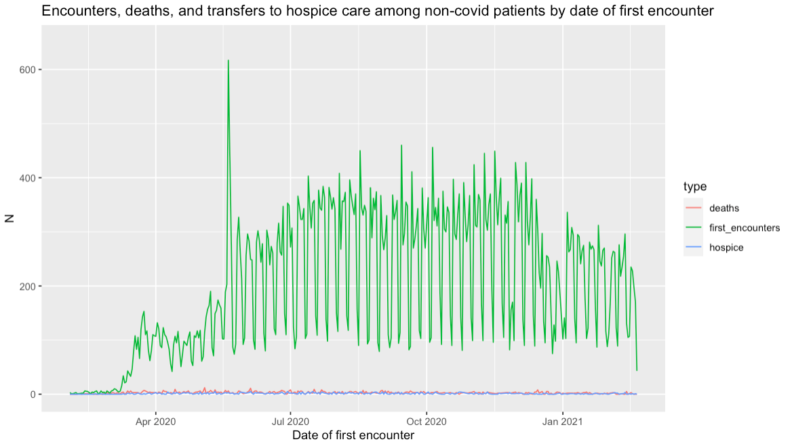
Notes:
If date was in the future, subtracted one year

Slide 6
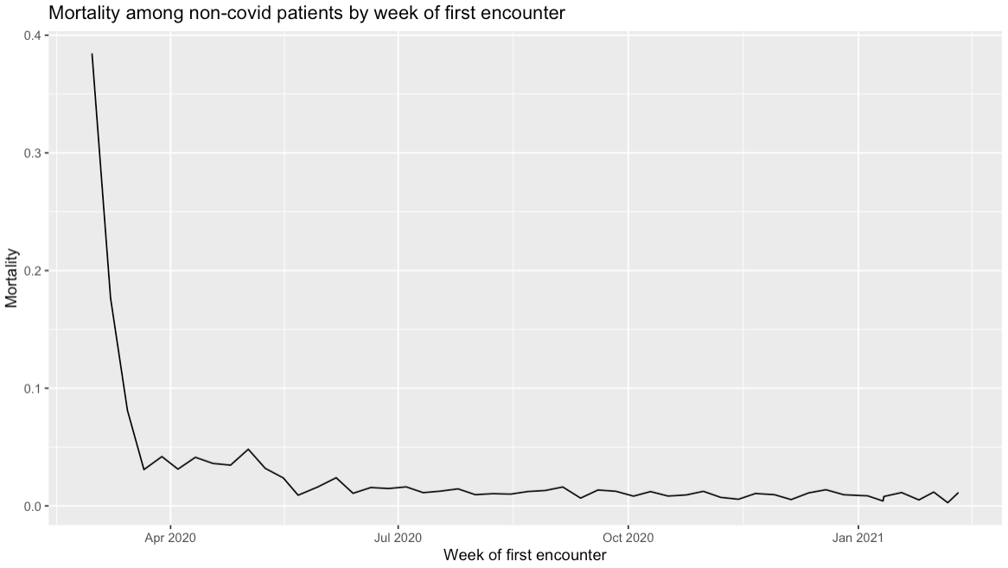
Notes:
(Does not include transfers to hospice care)

Slide 7
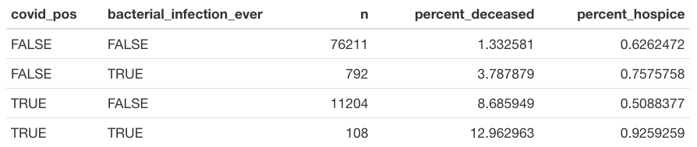
Overall mortality disaggregated by ever had a bacterial infection vs never had a bacterial infection, based on all specimens:

Slide 8
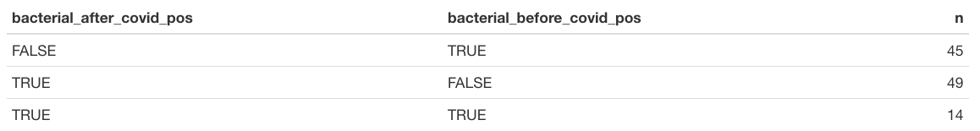
Did bacterial infections among covid patients take place before or after start of covid visits?

Slide 9
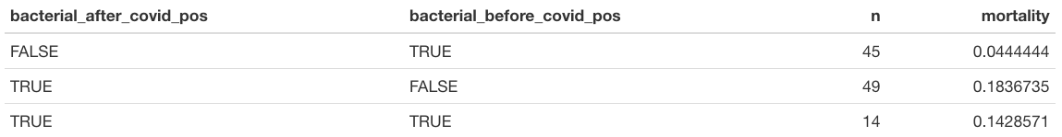

Slide 10
Tabulations on bacterial infections among covid patients to consider
When did they occur? Before during or after covid related stay? Was there a substantial population of people who had bacterial infections and subsequently got covid, or did most go covid then bacterial infection?
Blood confirmed vs other specimens
Compare mortality btw covid patients with in patient stays with and without bacterial infection
What kind of bacterial infection
Look at percent of covid patients who get bacterial infection over time

Slide 11
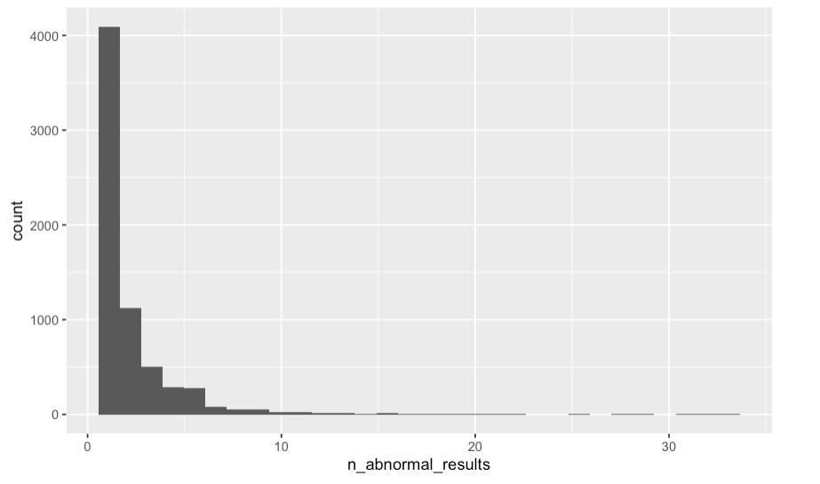
Number of abnormal results (number of instance, not number of organisms) per patient who ever had a bacterial infection – to get at patterns in testing
Notes:
Background exploration about testing for bacterial infections: Side questions that came up last time when we were talking about testing
Some overall questions about proportion of patients with bacterial infections – didn’t look into for now because we know we’re missing a whole bunch of info on them….

Slide 12
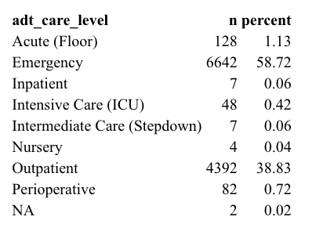
Background for “time in hospital” question How to define time in hospital?
ADT care level of first covid visit among
Patients who ever had a positive PCR
Notes:
Background for time in hospital for covid: how to define time in hospital?

Slide 13
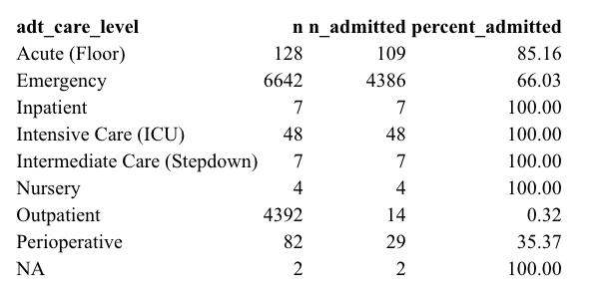
By adt care level of first covid visit, was the patient admitted in that same encounter?
Notes:
I haven’t yet looked into whether patients who were NOT admitted in that same encounter were then admitted subsequently. But, that might be of interest for outpatient and emergency visits, in particular.

Slide 14
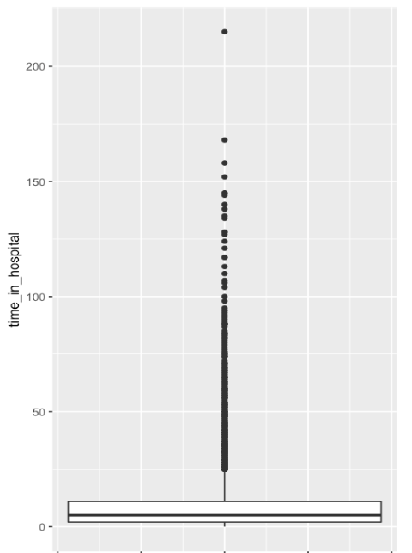
Time in hospital for those who were admitted during the first covid encounter (days between inpatient admission and discharge)
Notes:
Time in hospital: I assume we’re basically interested in the time in hospital of those patients who were admitted during that same “first covid visit”
Most are spending very little time, very few outliers are spending a lot of time.

Slide 15
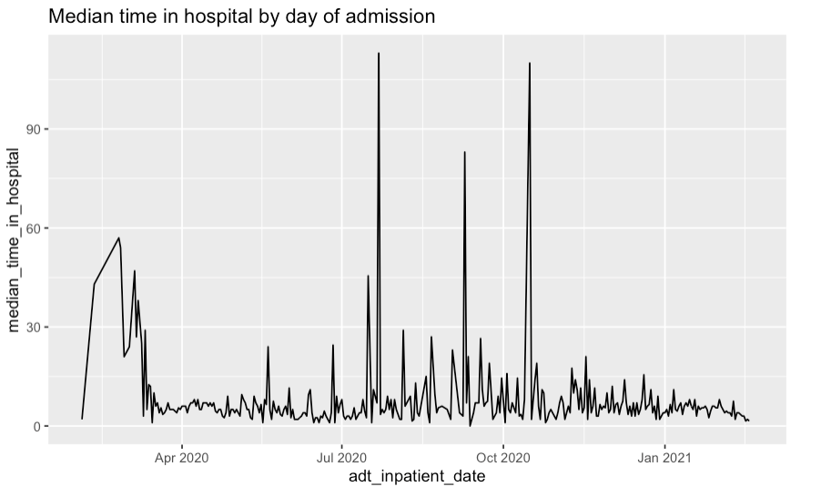
Notes:
(by date of inpatient admission)

Slide 16
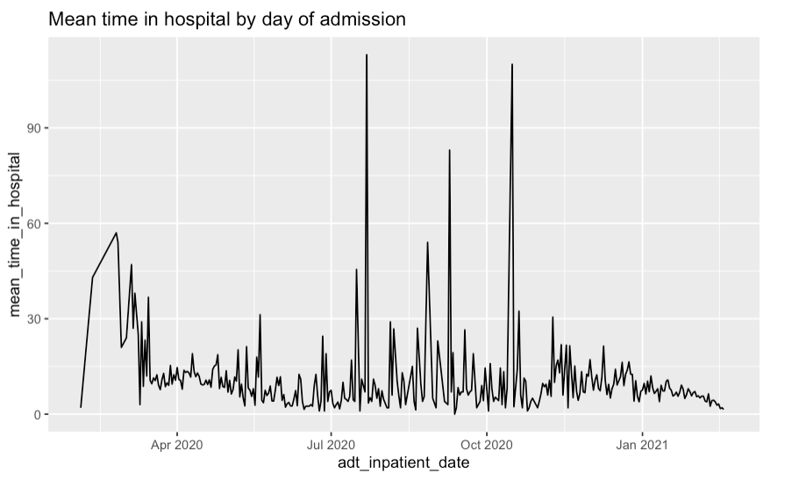

Slide 17
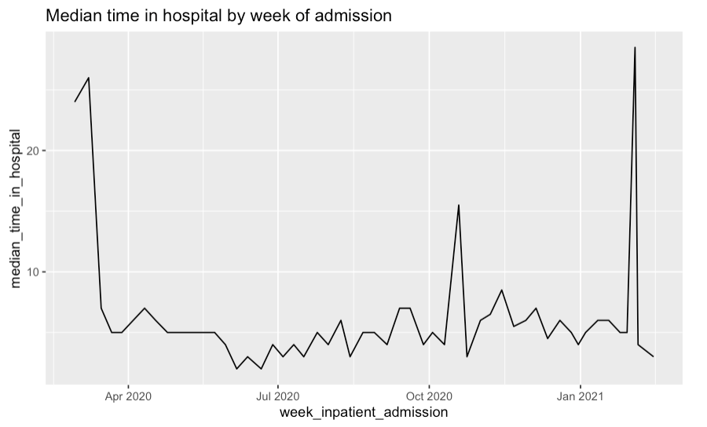

Slide 18
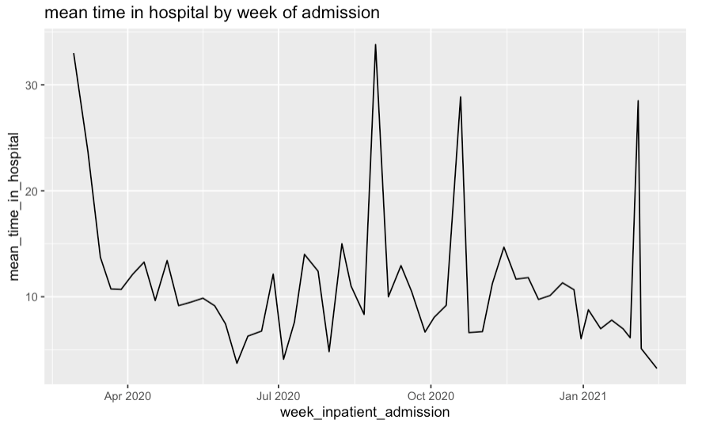

Slide 19
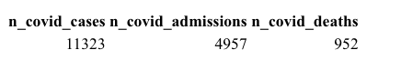
Present with covid → inpatient admission → discharge or death
admission rate mortality rate, time in hospital
Notes:
I have not yet looked at

Slide 20
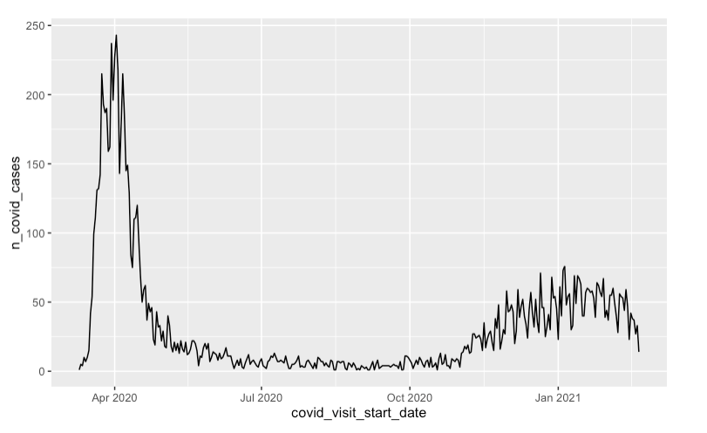
Covid positive PCR tests over time

Slide 21
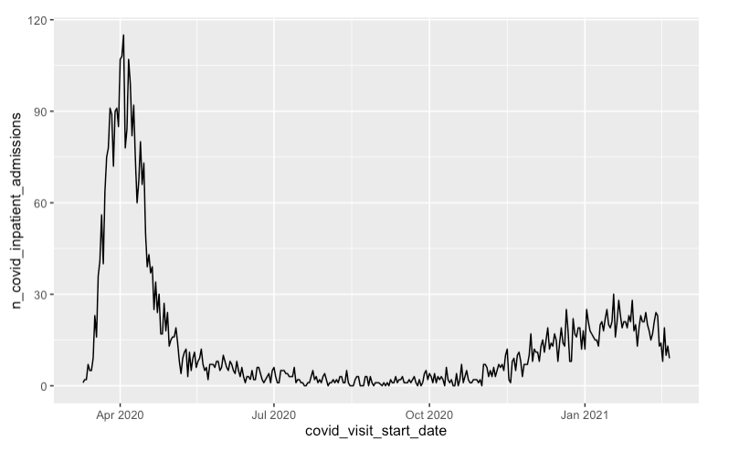
Covid inpatient admissions by date of first positive pcr test
Notes:
X axis is date of FIRST POSITIVE PCR TEST
I’d like to show you this over time, but this is what I’ve got so fart

Slide 22
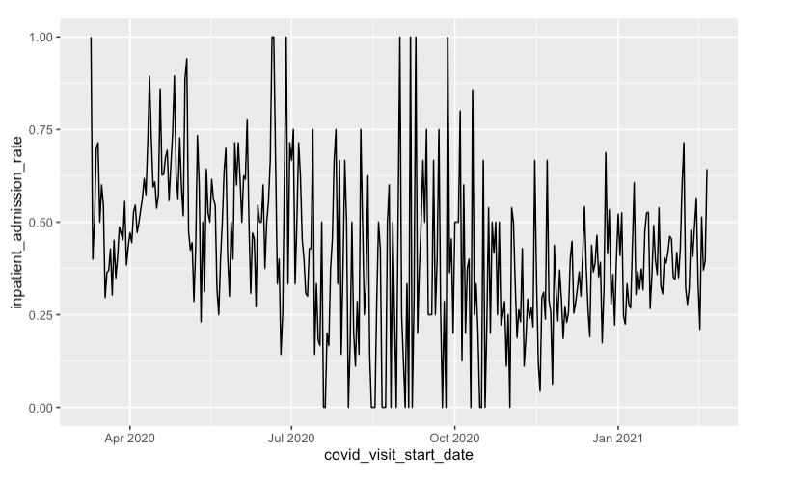
Admission Rate
Notes:
Decline: could have to do with care seeking being lower, or with improvements in management and treatment of covid, but doesn’t seem to have to do with

Slide 23
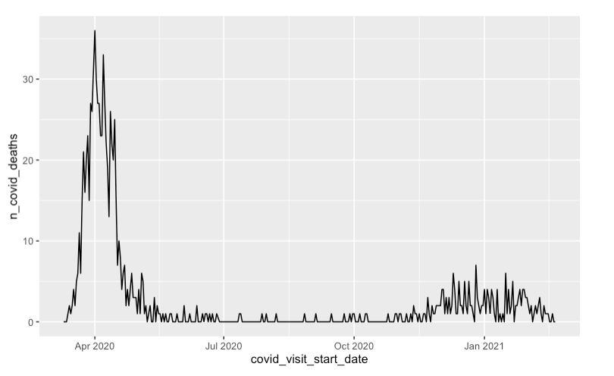

Slide 24
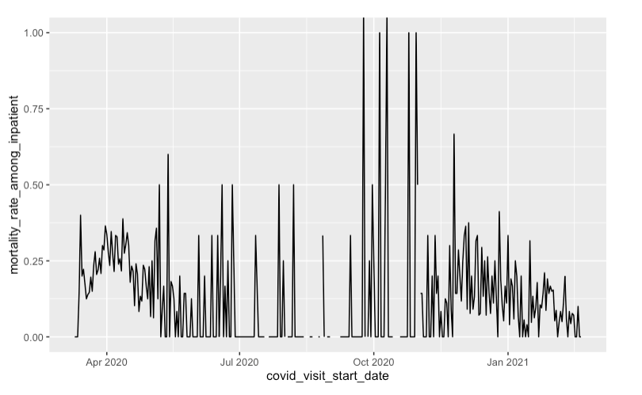
Mortality rate among inpatients with covid
Notes:
BY DATE OF FIRST POSITIVE PCR TEST

Slide 25
Questions about time in hospital:
Continue to look at time in hospital for covid patients?
How has time in hospital changed over time
What are predictors of time in hospital (consider bacterial infections)
Do we want to consider just the first admission for each patient, or all “covid admissions” based on the definition of an admission starting within 2 days prior – 7 days after first positive covid pcr test?
Time in hospital for patients with bacterial infections
Similar questions, look at covid as a predictor
Are we interested in total time in hospital, or time in hospital

Slide 26
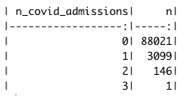
Various tabulations:
Number of covid admissions per patient among all patients in adt dataset:

Slide 27
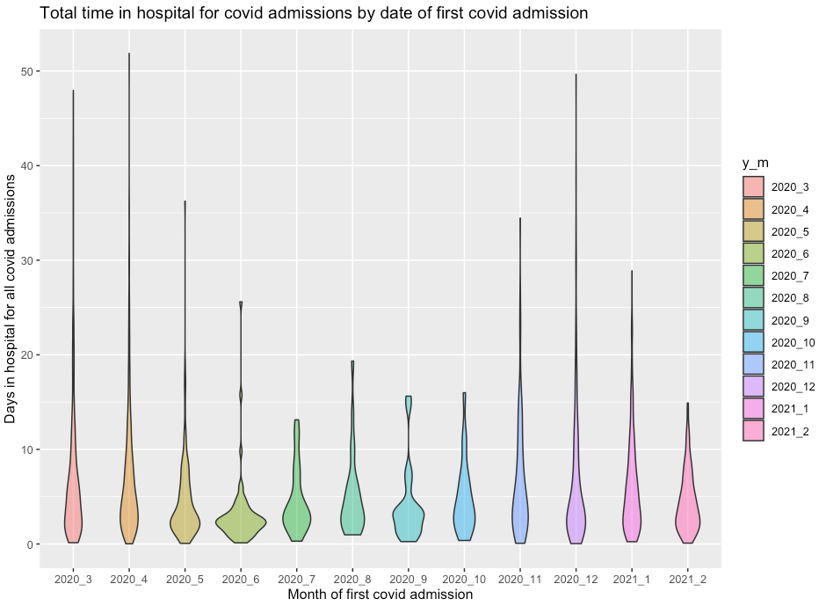
Notes:
Note: “covid admission” definitions will naturally exclude some subsequent admissions

Slide 28
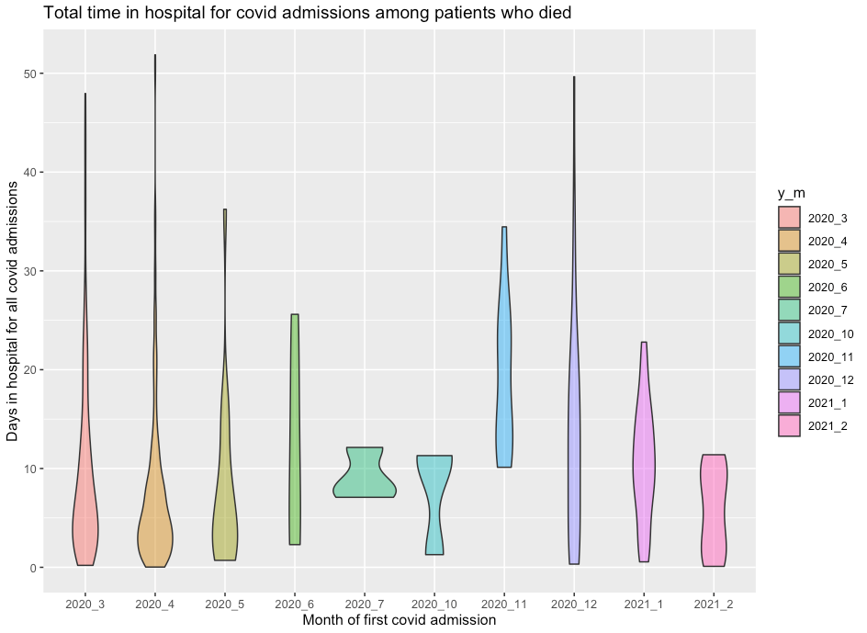
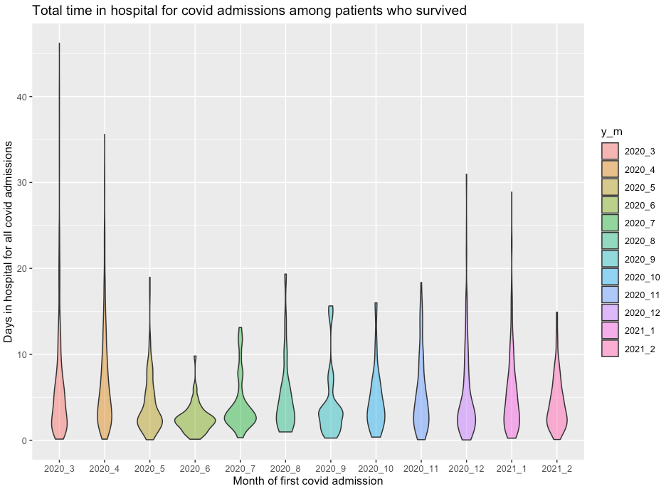
Disaggregated by deceased/not deceased
Notes:
Note: deceased and not deceased based on final outcome, NOT outcome after these two admissions, based on the information that we had about the patient.

Slide 29
Overview of available data in ADT, covid and micro datasets (by mrn) – As of February 2021 data update
ADT
91,265
Covid
112,106
72,972
0
20,805
18,293
0
36
7099
Micro
25,428
Notes:
Made with data through February 2021

Slide 30
Overview of available data in ADT, covid and micro datasets (by mrn) – As of February 2021 data update
ADT
91,265
Covid
112,106
79,005
0
38,322
21,387
0
547
2347
Micro
25,428
Notes:
Updated with data through May 2021

Slide 31
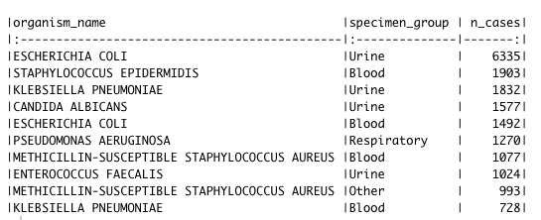
Most common organism – specimen combos
Notes:
Updated with data through May 2021

Slide 32
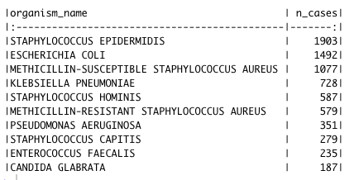
Most common organisms for blood specimens only
Notes:
Note – these are the most common positive TESTS, rather than the most common infections/organisms. Some organisms may have different patterns of testing.. Ie, this tabulation is per test not per infection

Slide 33
Determining whether multiple positive tests for an organism in a patient are separate or the same infection:
Do the positive tests occur during the same or different inpatient stays?
Separate infections
Different
Same
How much time is elapsed between consecutive tests?
> 30 days
Same infection
Ambiguous
< 7 days
7 – 30 days
Notes:
Based on conversation with Anne-Catrin, Jason and Jeff. I realize this is an over-simplification, Anne-Catrin and Jason, but I wanted to get a ballpark idea of how many ambiguous cases we had to see whether it would be worth our while/necessary to review cases individually,

Slide 34
How many cases are there with ambiguous gaps in positive tests?
Each of these is per person, per inpatient stay, per organism.
Total N person-inpatient-organisms = 2290
Cases with a lapse of: | N | Percent of cases
3-7 days | 55 | 2.4%
7-30 days | 45 | 2.0%
>30 days | 18 | .8%
Notes:
Note – in calculating these I have not taken into account whether there were negative tests in between nor how many – just looking at the time that elapsed between consecutive positive tests for a given organism, inpatient stay, and patient
There may be overlaps between these categories, too – ie, one person-inpatient-organism case may have a lapse of 4 days and also a lapse of 14 days, or something.
I suggest: Since there are not many cases here, Anne-Catrin and Jason do not review case by case yet – I proceed with a little more analysis keeping records of what rules I used, and if necessary, AC and Jason can review later if we all decide it’s worthwhile.

Slide 35
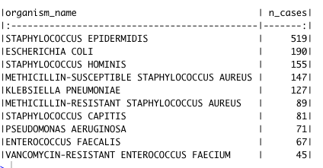
Most common blood infection (N = 2290, some of these may be > 1 infection)
Notes:
Updated 6/21: now divides 30 day lapses into two infections, lapses of less than 30 days are considered the same infection

Slide 36
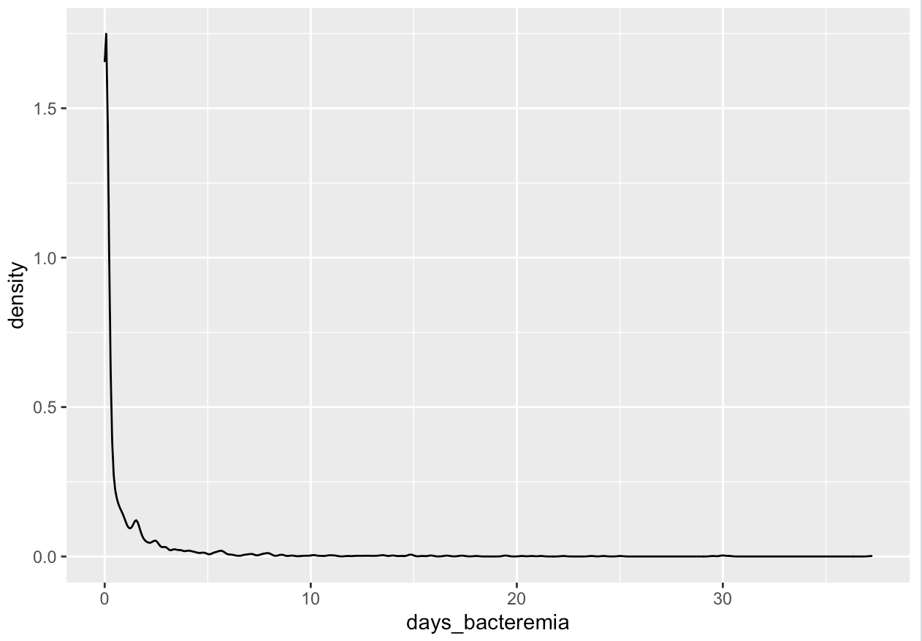
Duration of bacteremia for all blood infections Excludes those with only one positive test (0 time of bacteremia). For the moment, infections with lapses in positive tests of 7-30 days are included
Notes:
Excludes those with only one test

Slide 37
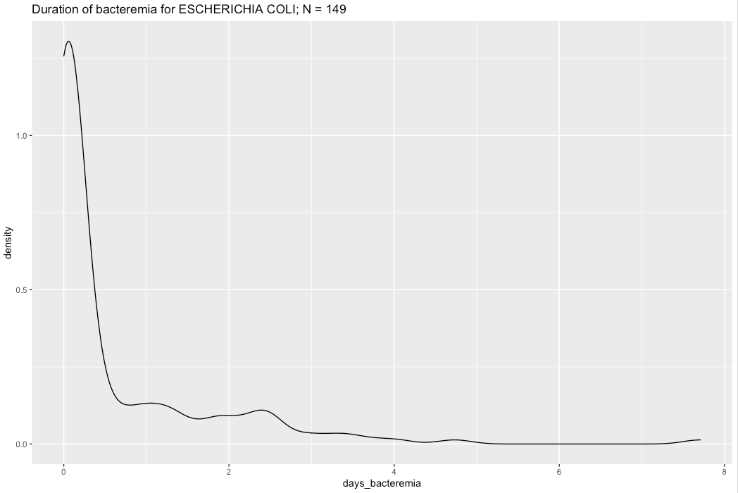

Slide 38
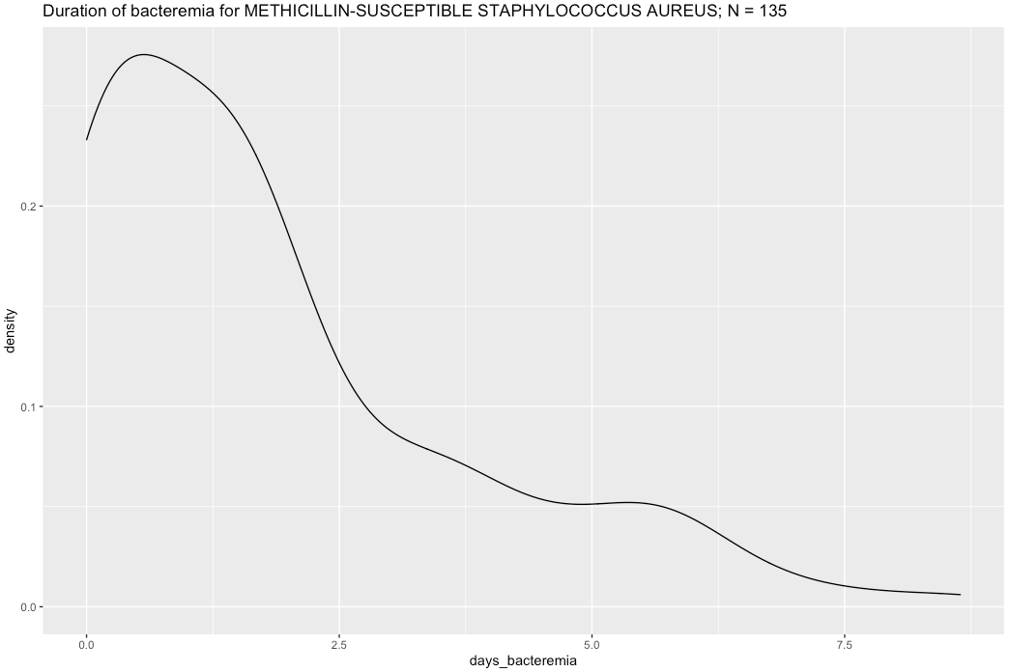

Slide 39
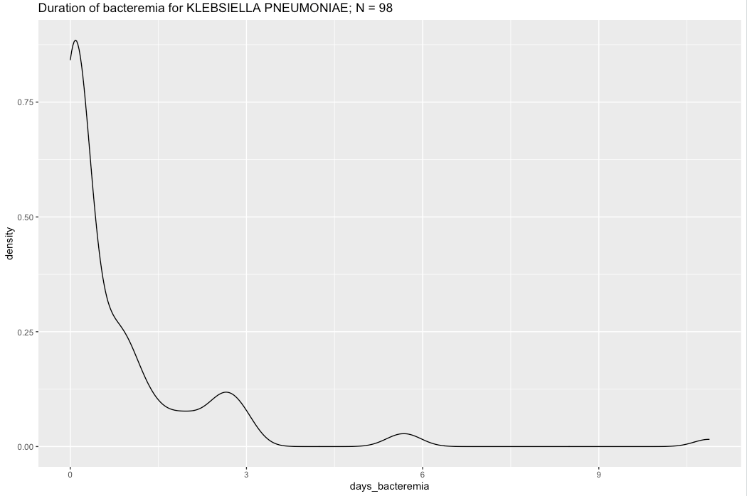

Slide 40
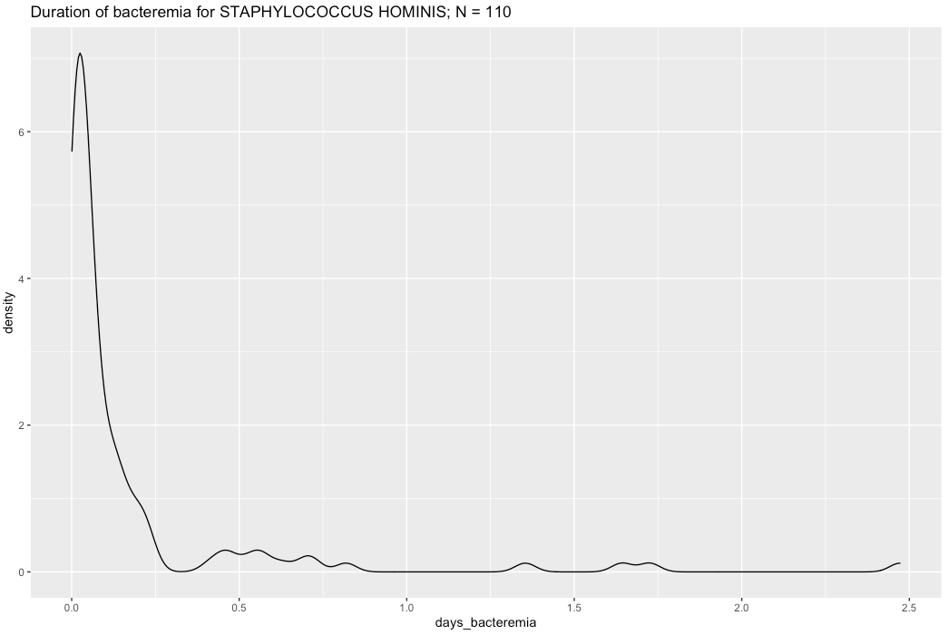

Slide 41
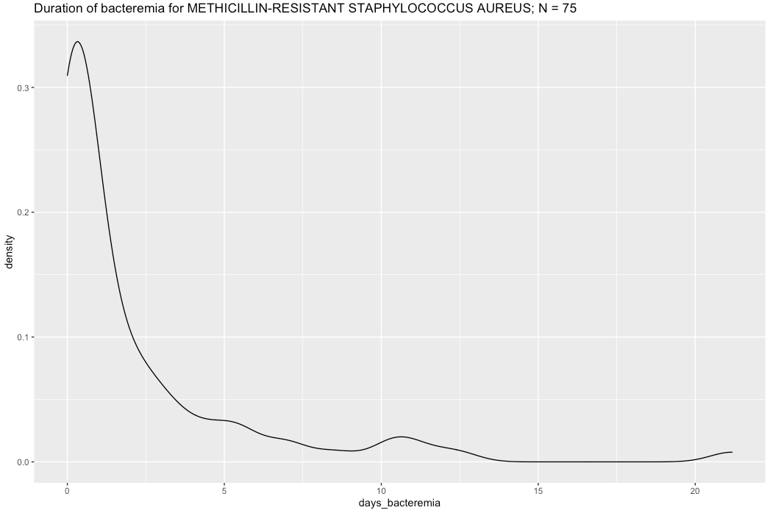

Slide 42
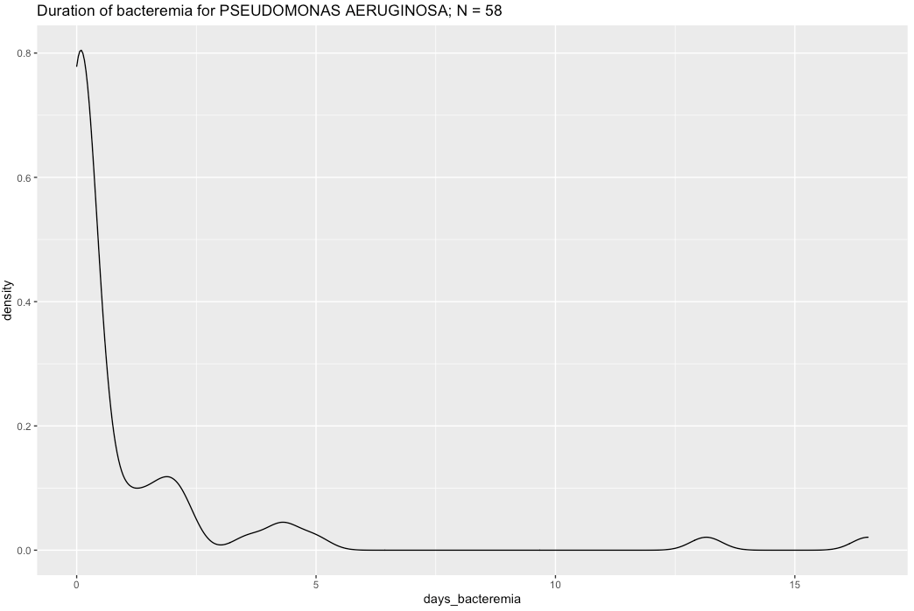

Slide 43


Slide 44


Slide 45
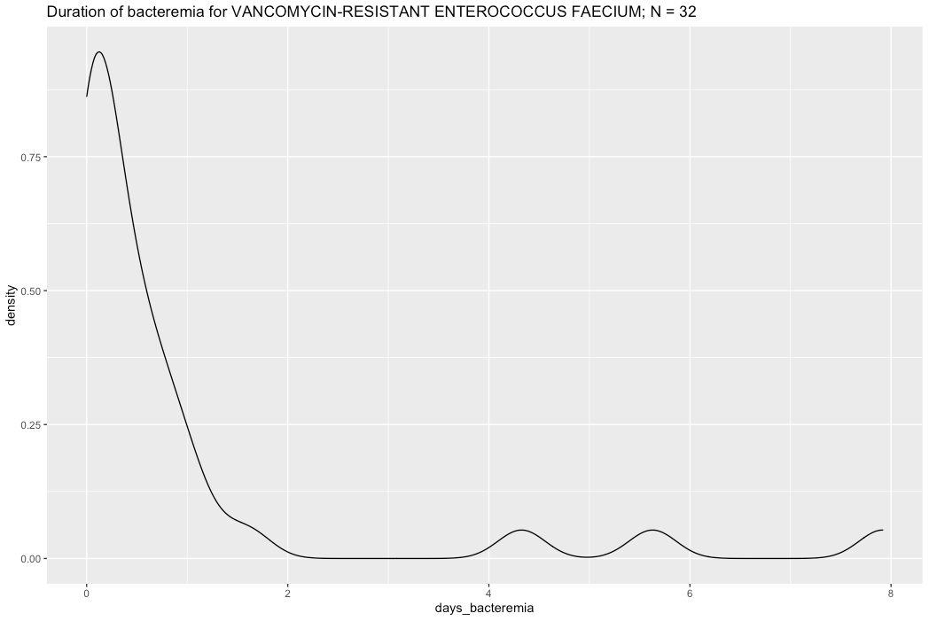

Slide 46
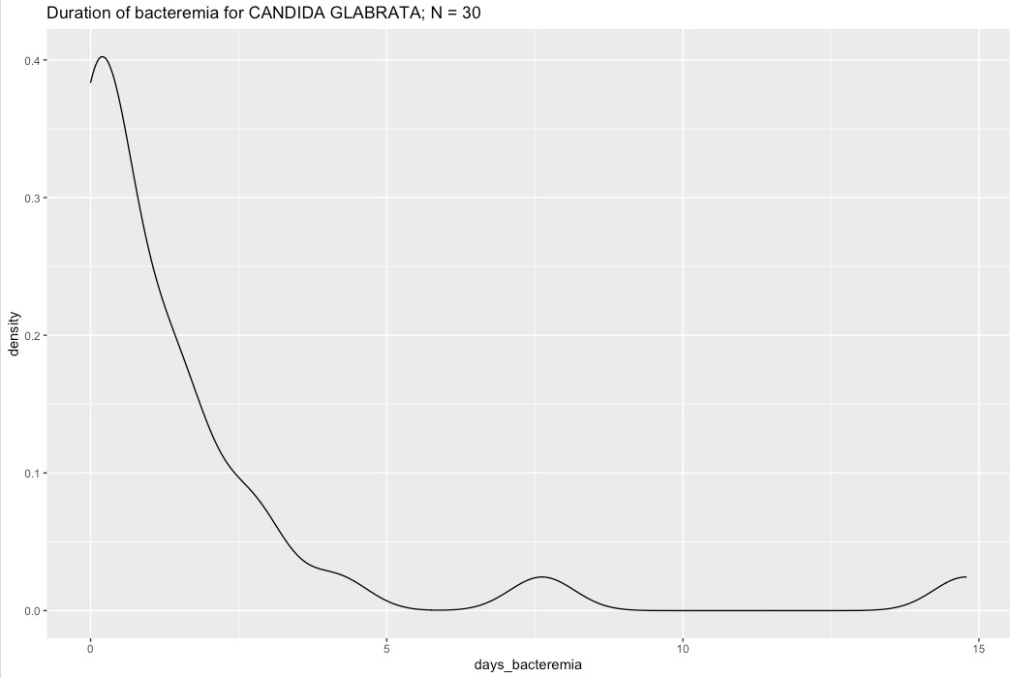

Slide 47
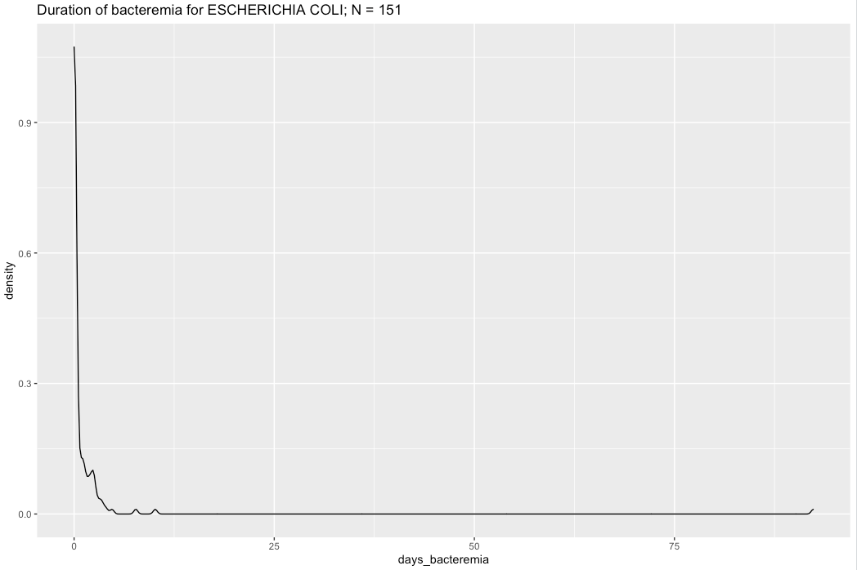

Slide 48
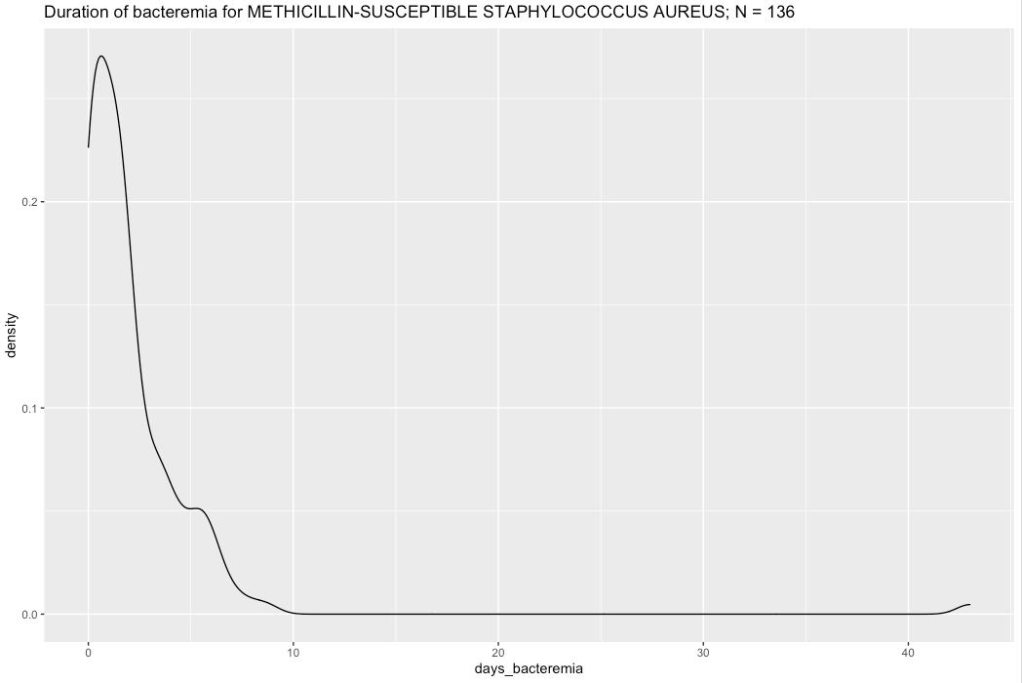

Slide 49
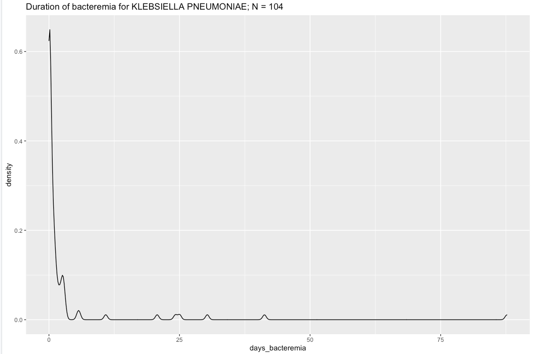

Slide 50


Slide 51
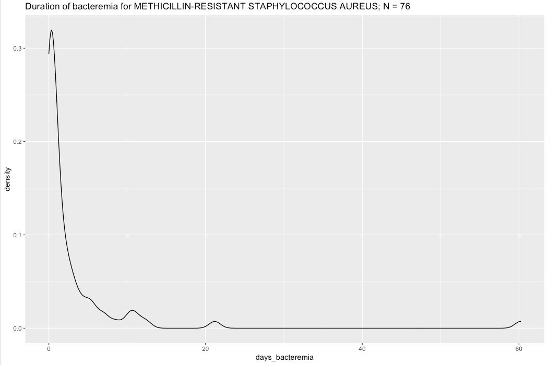

Slide 52
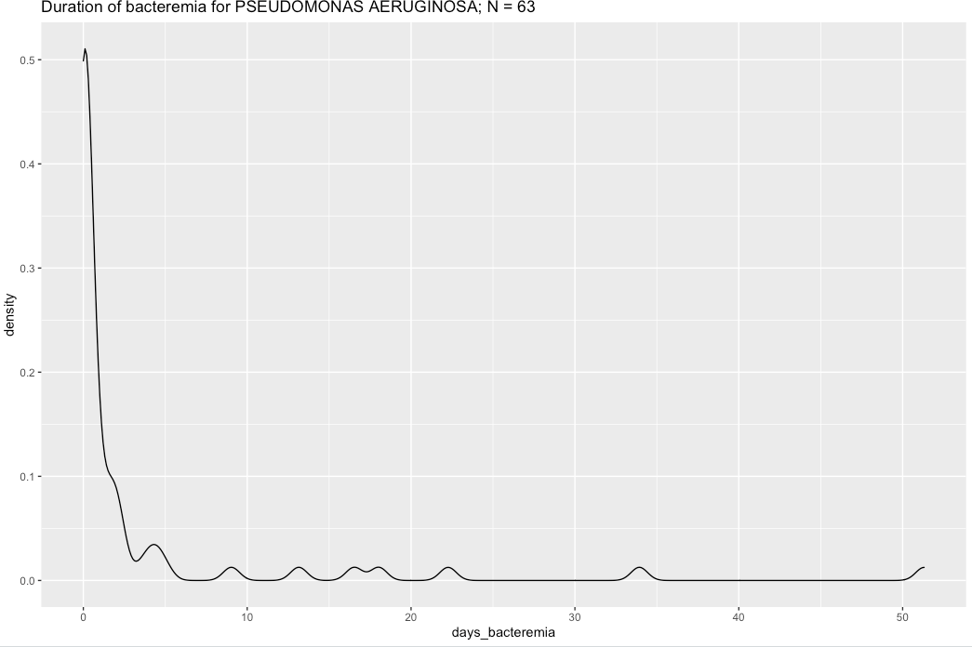

Slide 53
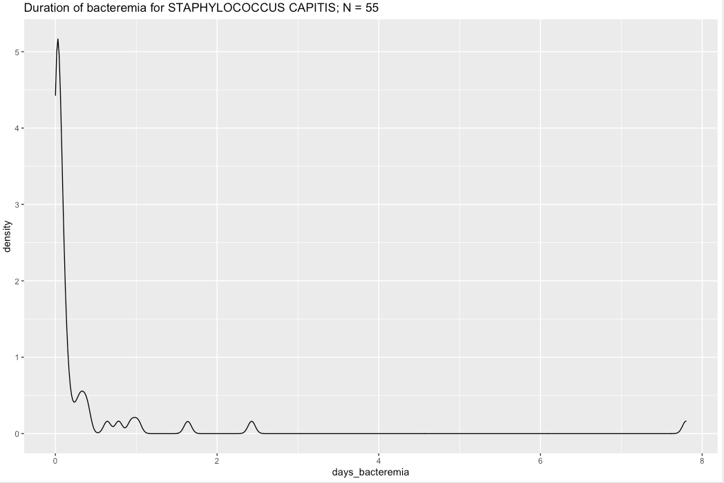

Slide 54


Slide 55
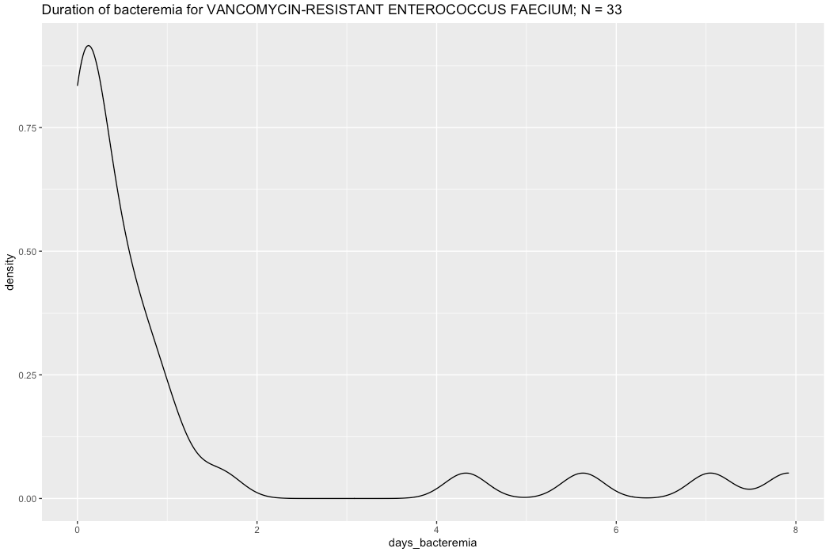

Slide 56
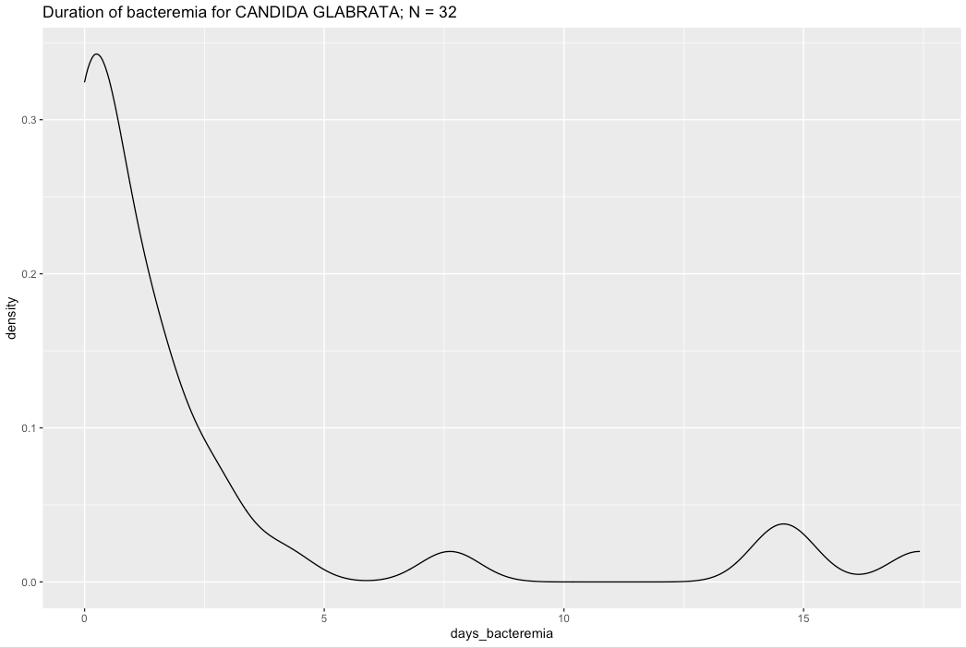
Notes:
Questions: What predictors are we interested in related to duration of bacteremia? I imagine we should look at organisms individuals (or should I break down by gram negative and then disaggregate for gram pos by staph and entero viruses, as AC suggested Claire do?

Slide 57
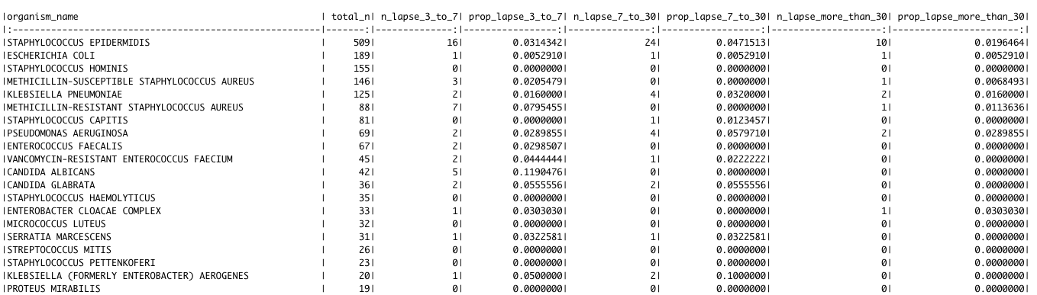
Lapses in positive tests: per patient per inpatient stay per organism, by organism

Slide 58
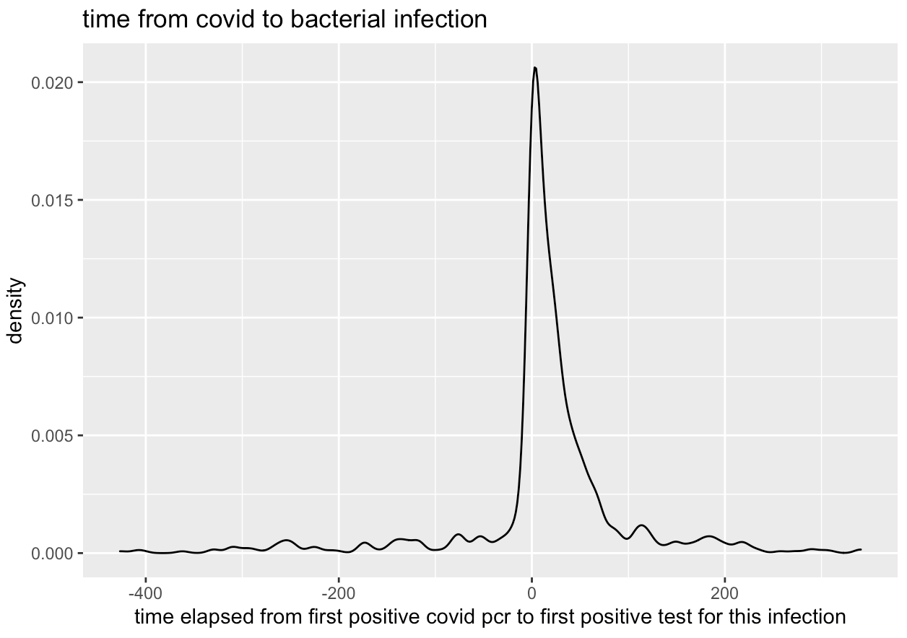
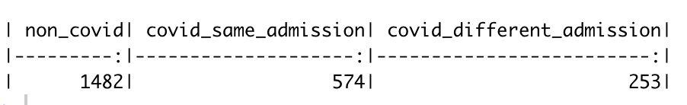
When do bacterial infections take place with respect to covid diagnosis? Per infection (not per patient). N = 2309
Above: per bacterial infection, was the infection in a patient who never had covid, in a patient who had covid during the same hospital admission, or in a patient who had covid during a different inpatient admission? Covid during inpatient admission = first covid pos pcr took place adt event and discharge or within 48 hrs prior to adt event
Notes:
Second category: continuous stay or multiple inpatient stays? Ie, were they infected with covid in the hospital
Same for final group: same stay or not?
Plot distribution of time after covid identification that bacterial infection was identified – was it picked up, or just about order in which tests took place?
Most bacterial infections soon before/after covid infection

Slide 59
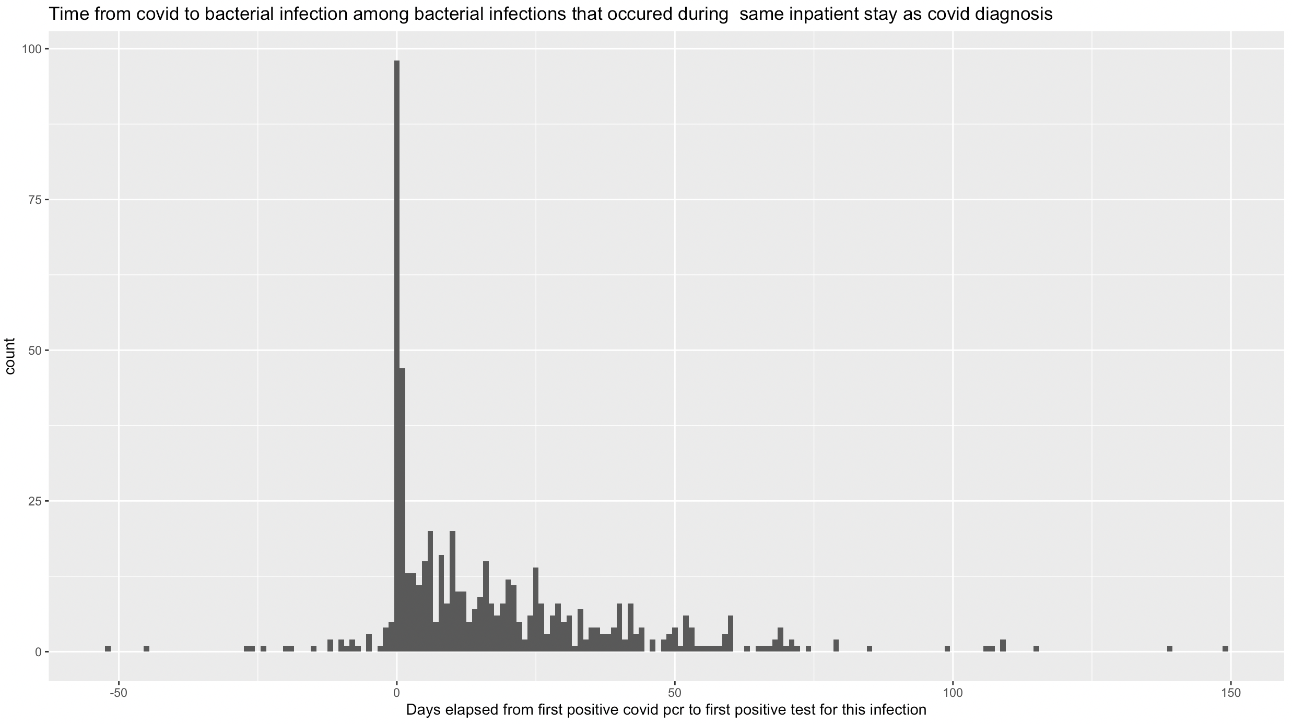
N = 574 bacterial infections, from 407 patients
Notes:
Considered “occurred during same inpatient stay” if time of first positive pcr test occurred between 48 hours prior to adt event time and adt discharge time.

Slide 60

Bacterial infections by organism: non-covid, covid admission, or in covid patient but during a different admission?

Slide 61


Duration of bacteremia in infections that took place during covid vs non-covid admissions

Slide 62

7/19/21: slide with some extra info
How many infections did each covid patient have that occurred during covid inpatient admissions?

Slide 63
More extra info:
Bacterial infection = any positive blood test excluding the three common contaminants that Jason mentioned at our last meeting
Covid admission: inpatient admission beginning within 48 hr before or 7 days following first positive covid pcr – will be expanding this definition to make sure transfers are included.

Slide 64



9/13/21:
Start here to review the slides we looked at last time
Bivariate linear regression:
KS: difference in distributions:
Notes:
Ks = Kolmogorov-smirnov test
9/13/21: Start here

Slide 65


The difference in length of stays is biased by the fact that a longer stay presents more opportunities for infection. Many patients without bacterial infections were not even at risk (no longer in the hospital!) at the time of stay that many of these infections occurred
Notes:
For thos who didn’t have bacterial infections, major drop in time in hospital by day 25 – but note that many of the infections are actually happening AFTER that. So, this isn’t a suitable comparison to assess the potential impact of infections on time in hosp.

Slide 66

Method to account for this bias: risk-set matching
Compare patients who acquire infections to comparable patients who are still at risk at time of infection
Notes:
(so, someone who acquires an infection on day 15 will not be compared to someone who was discharged on day 3..)
Other examples in Rosenbaum text: heart transplants (some people die before treatment becomes available); effects of surgery on interstitial cystitis
Watson, Spauldin and Dreyfus call this a selection bias, others call this a version of the “immortal time bias”

Slide 67
Risk-set matching
Variation of propensity score matching
Propensity score matching – causal inference method used to estimate the effect of a treatment/exposure (bacterial infection) by matching treated/exposed individuals with controls using modelled propensity for the exposure.
Traditional propensity score matching: uses logistic regression to estimate propensity vs risk-set matching: uses survival analysis (cox proportional hazards regression) to estimate propensity – propensity is the hazard of infection at time of infection

Slide 68


Preliminary results from risk-set matching:
Minimal preliminary matching so far – propensity score based just on sex and age at admission
Notes:
227 individuals with covid and bacterial infections during same visit – only 152 were matched. Could be I did something wrong? Or perhaps they weren’t match-able….?
Still room for bias – mostly have just made sure it works.
9/12/21: this is just wrong!! Created using the rsmatch package, which didn’t seem to be doing what I expected it to be doing……

Slide 69
What variables to include in matching model?
Basic demographics: age, sex, race, ethnicity, insurance type
What clinical variables should be included?:
ICU stays
Chronic disease
Catheters
Central line
Etc?
Baseline or time-varying variables
What defines a separate observation in the adt datasets? If a patient is transferred to ICU, is that a separate obs?
Has anyone used rsmatch package in R or done risk set matching?
Notes:
Obviously there’s still a lot to do: I haven’t included most variables in matching yet! Also,

Slide 70
Still to do:
Set up dataset with all covariates we’d like to include, including time-varying
Adjust definition of “covid admission” to make sure transfers are included as part of the stay
Notes:
Update before presenting this 9/13

Slide 71
Preliminary risk-set matching analysis:
208 individuals who had bacterial infections (blood) during covid related inpatient stays were each matched with a control
Preliminary list of variables that were included in the propensity score: age at admission, sex, combined race and ethnicity, insurance type, date of admission
Matching procedure that I used allowed for the possibility that not-yet-infected people who later got infections could be selected as controls for earlier infections.
4927 people in dataset: individuals who had covid inpatient stays and did not have missing data
208 (~4.2%) of these individuals had bloodstream bacterial infections
22/208 (~10.6%) of controls were individuals who subsequently had infections themselves and were therefore included in both exposed and control groups.
Notes:
Aligned with literature, in that these individuals are more likely to have a similar propensity.
If time, maybe add a little graphic of what the risk set matching is doing, or of the population/exposure/outcomes of interest.

Slide 72



Output of coxph model of bacterial infection onset
This is not the main result of interest of the risk set matching analysis, but an intermediate result (assessing the propensity of acquiring a bacterial infection) that we might like to see the results of.

Slide 73
Comparison of covariate balance before and after matching procedure

Slide 74

Graph of time in hospital before and after matching procedure

Slide 75



T-test results
Unmatched samples:
Matched samples: Matched paired t-test:
Notes:
As we saw in related literature,

Slide 76

Change matching algorithm to consider only never-infected people as controls:

Slide 77


T-tests with second matching algorithm:
Matched samples:
Matched samples – paired t-test

Slide 78
What happens if we put the same variables used for the propensity score matching method into a regression model?
Notes:
If time, add this.

Slide 79
Next steps
Incorporate more variables into the propensity score
A few data processing fixes:
to make sure that time in hospital is correctly calculated
Addressing missing data
Try a couple of sensitivity analyses to make sure our matching procedure isn’t introducing a bias. For instance, try:
Not including later-infected people as potential controls
Selecting controls on a daily basis rather than one individual at a time
Selecting multiple controls
Write up to share: covariate balance before and after matching procedure

Slide 80

Question for group: revisit questions of what variables to include in propensity score model
From Watson et al:
BMI
Comorbidities – cardiovascular disease, diabetes,
Kidney disease
Central line – anything that breaks skin – trickier to find I
N data. Look in procedures.
Consider same analysis on non-covid patients
Notes:
Realized in reviewing notes for this meeting – neglected to add in BMI in the model. I will add that!

Slide 81
Revisit risk-set matching model to assess impact of HAI on length of inpatient stay among covid patients
Updated to most recent datasets:
Updated date of bacterial infection to be date of collection, rather than date of order
Updated definition for “covid inpatient admission”: now includes anything from previous definition, plus, anything starting within 48 hrs of a covid admission ending – indicating either a transfer or readmission. Makes a difference for about 150 admissions.
Added additional variables: bmi, comorbidities – diabetes, kidney disease, cardiovascular disease

Slide 82
Last time we discussed covariates to add to model
Demographics (already included): age at admission, sex, race/ethnicity, insurance type
Bmi: I pulled from covid_wide dataset - seems to be missing for about 10% of people.
Comorbidities:
Diabetes
Kidney disease
Cardiovascular disease
Procedures: I have not tackled yet.

Slide 83

Updated results:
Unmatched sample T-test:

Slide 84

Notes:
This slide not updated.

Slide 85

Matched sample t- test:

Slide 86


Slide 87

Again, if we don’t include later-infected people in pool of controls:

Slide 88


Slide 89
Notes 11/21:
Fixed error: since some micro records had “order_dt” only and some had “collected_dt” only, I was missing some of the blood results (232 mrns vs 203 mrns had blood bacterial infections)
To include in slides: for each of urine, respiratory and blood:
Tabulate total number of infections
Show graph, matched and unmatched T-test (table of all t-tests?)
Table of top ten organisms for covid patients and non-covid patients

Slide 90


Bacterial infections - blood
N = 315 infections
N = 1581 infections
Notes:
Excluding staph epi, staph hominis, staph capitis

Slide 91


Bacterial infections – urine
N = 713 infections
N = 3601 infections

Slide 92


Bacterial infections - respiratory
N = 577 infections
N = 1711 infections

Slide 93




Risk-set matching - blood

Slide 94




Risk-set matching - urine

Slide 95




Risk-set matching - respiratory

Slide 96
Risk-set matching – individual pathogens
Look at one site and one organism at a time
Ignore infections at other sites – do not factor them in to analysis
Eligible controls for matching: have not had infection with pathogen of interest by time of infection of the exposed patient; nor have had another infection at the same site.
Multiple infections in the same patient: so far, considering just the first infection that is detected.
Concern about: For many site – pathogen pairs, too little data
Propensity: add prior infections as predictor
Notes:
(too little data for cox model to run)

Slide 97



E Coli example:

